Slide 1

Multievent: the capture-recapture of uncertain states
Biostatistics and Population Biology team
CEFE, Montpellier, France

Slide 2
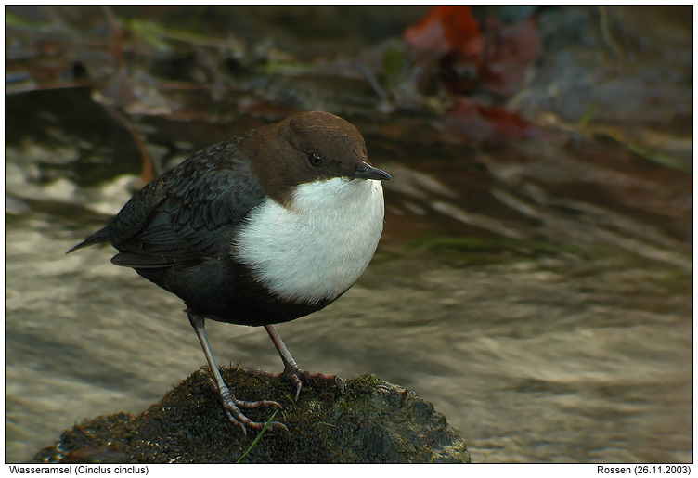
The simplest CR data
(Cormack-Jolly-Seber model)
European dipper
individual marks
K occasions
encountered
not encountered

Slide 3
The simplest CR data
(Cormack-Jolly-Seber model)
encountered code ‘1’
not encountered code ‘0’
each individual has an encounter history
Time :
1 2 3 4 5 6 7
1 1 1 1 0 0 0 Individual # 1
1 1 0 0 0 0 0 Individual # 2
1 1 1 1 1 1 0 Individual # 3
...
0 0 1 0 1 0 0 Individual # i
...
0 0 0 0 0 1 0 Individual # 254
0 0 0 0 0 1 1 Individual # 255

Slide 4
The simplest CR data
(Cormack-Jolly-Seber model)
what we know: ‘encountered’ or ‘not encountered’
what we want to know: ‘alive’ or ‘dead’
Vocabulary
what we perceive: the events
what is hidden: the states

Slide 5
The simplest CR data
(Cormack-Jolly-Seber model)
the state process takes place between times t and t+1:
alive at t
alive at t+1
with probability φ
dead at t+1
with probability 1-φ
dead at t
dead at t+1
with probability 1
the state process depends on the last state reached.
(first-order Markov process)

Slide 6
The simplest CR data
(Cormack-Jolly-Seber model)
the event process takes place at time t:
alive at t
encountered with probability p
not encountered with probability 1-p
dead at t
not encountered with probability 1
the event process depends on the current state

Slide 7
The simplest CR data
(Cormack-Jolly-Seber model)
Vocabulary
The probabilities that describe the state process are called transition probabilities.
Those that describe the event process are called event probabilities.

